Slide 1
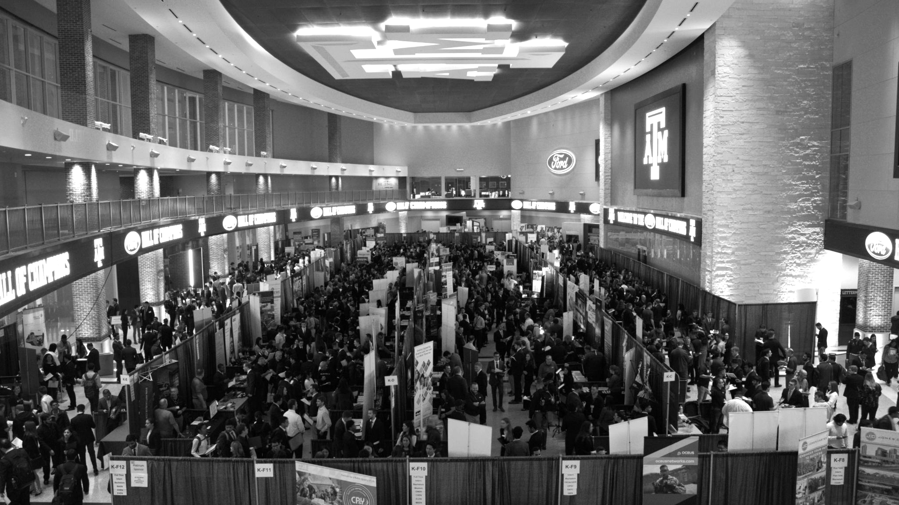

LANL Team Project Update
4/14/2025
Izzy Baumler, Dalton Boeckmann, Morgan Gullo, Jade Waldron

Slide 2
Problem Statement/Project Motivation
There is a need for a technology that has 5 DOF and can move through its full range of motion in each degree of freedom of at least 1 Hz.

Slide 3
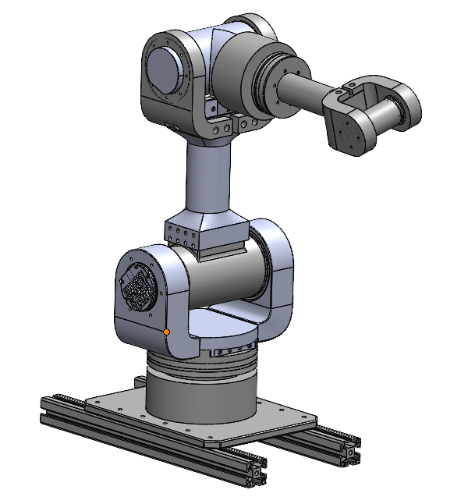
Weekly Assigned Tasks
Jade - Solidworks Refinement/Prototyping/Assembly
Izzy - Motor Research and testing
Dalton - Assembly/Motor Testing
Morgan - Purchase Orders/Electrical

Slide 4
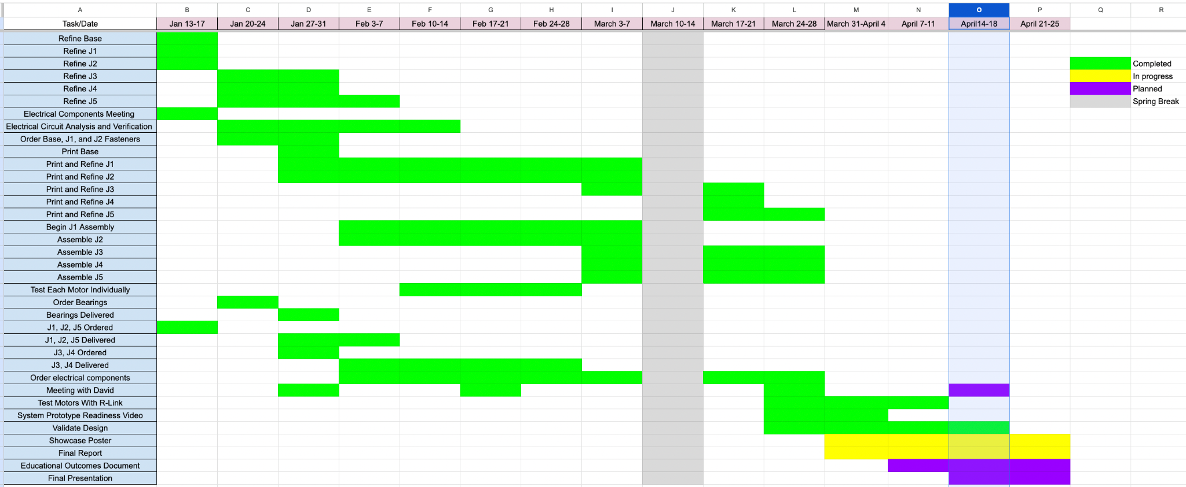
Schedule Update

Slide 5
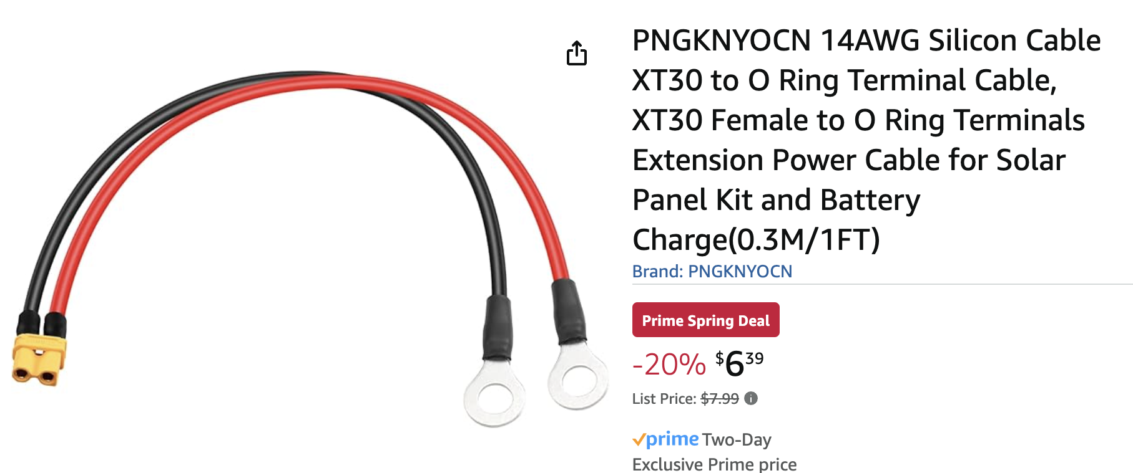
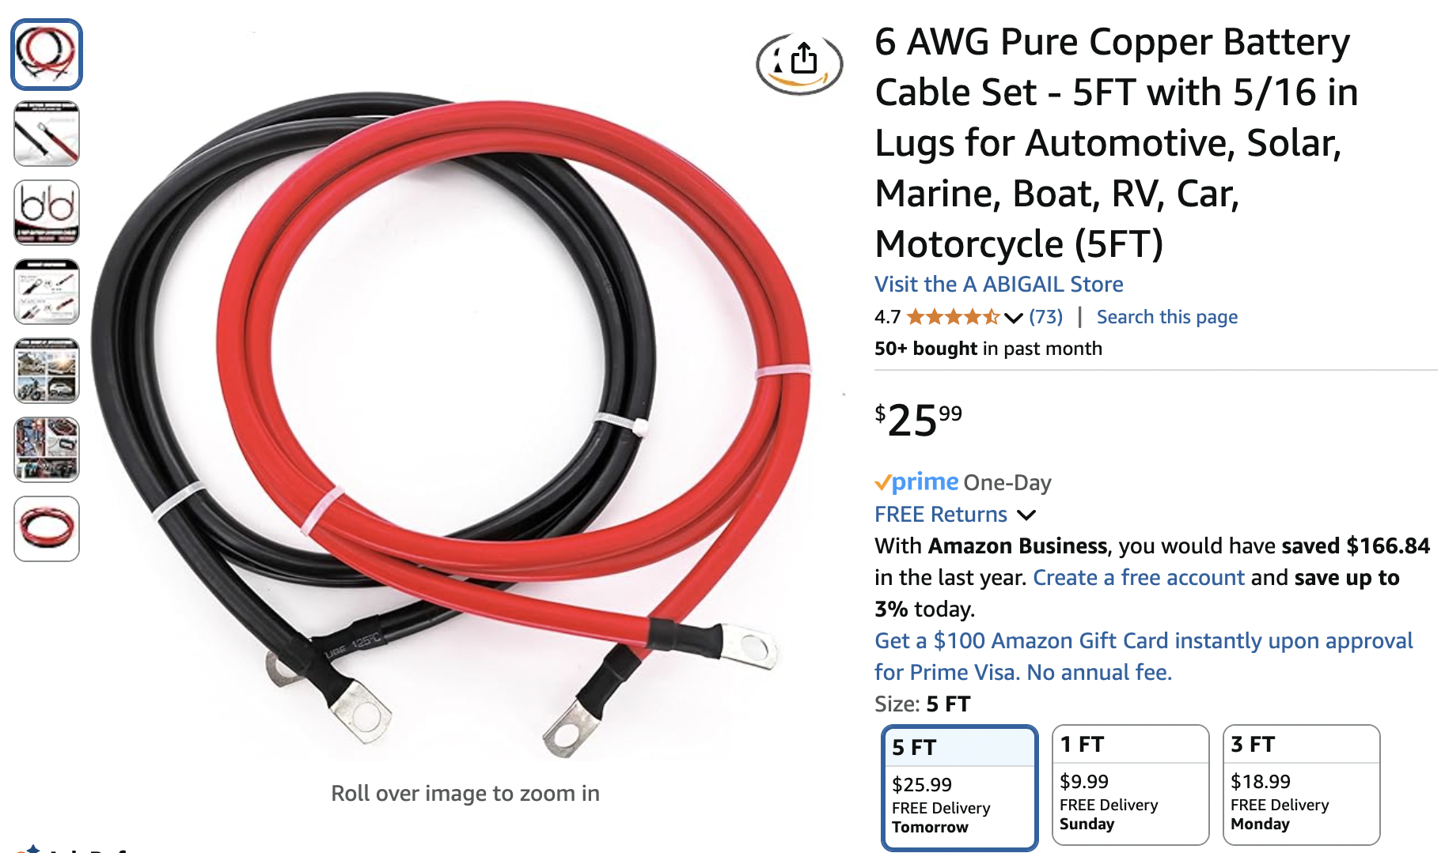
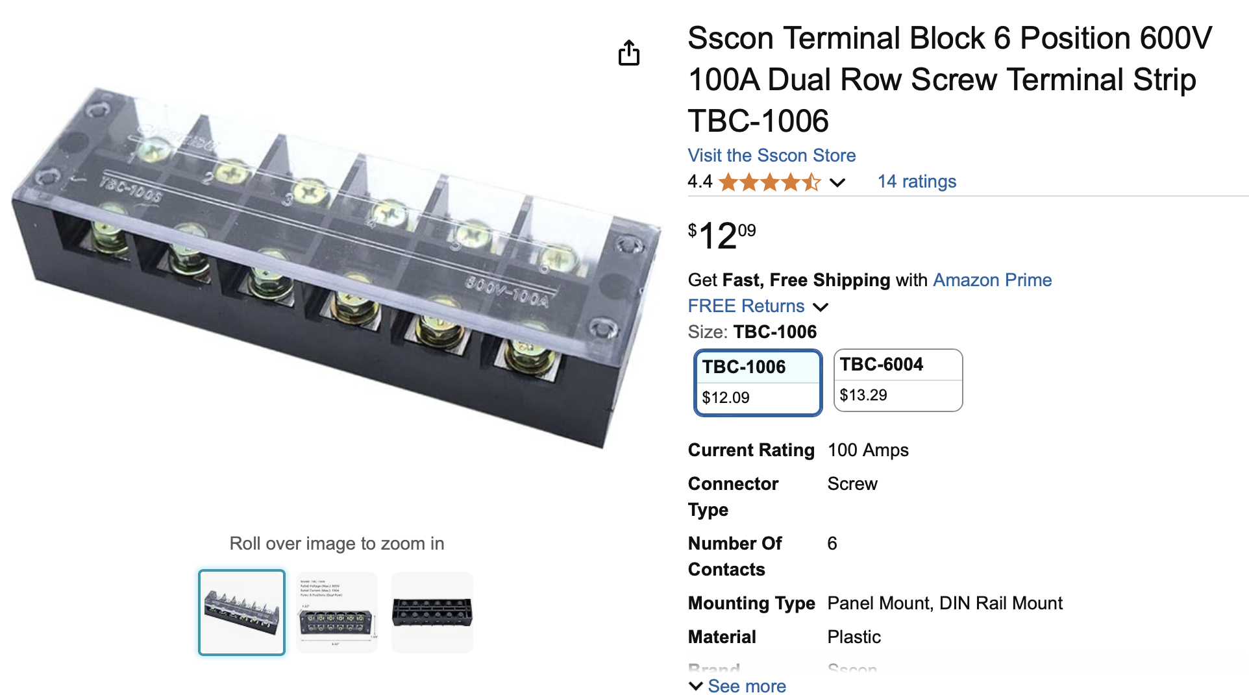
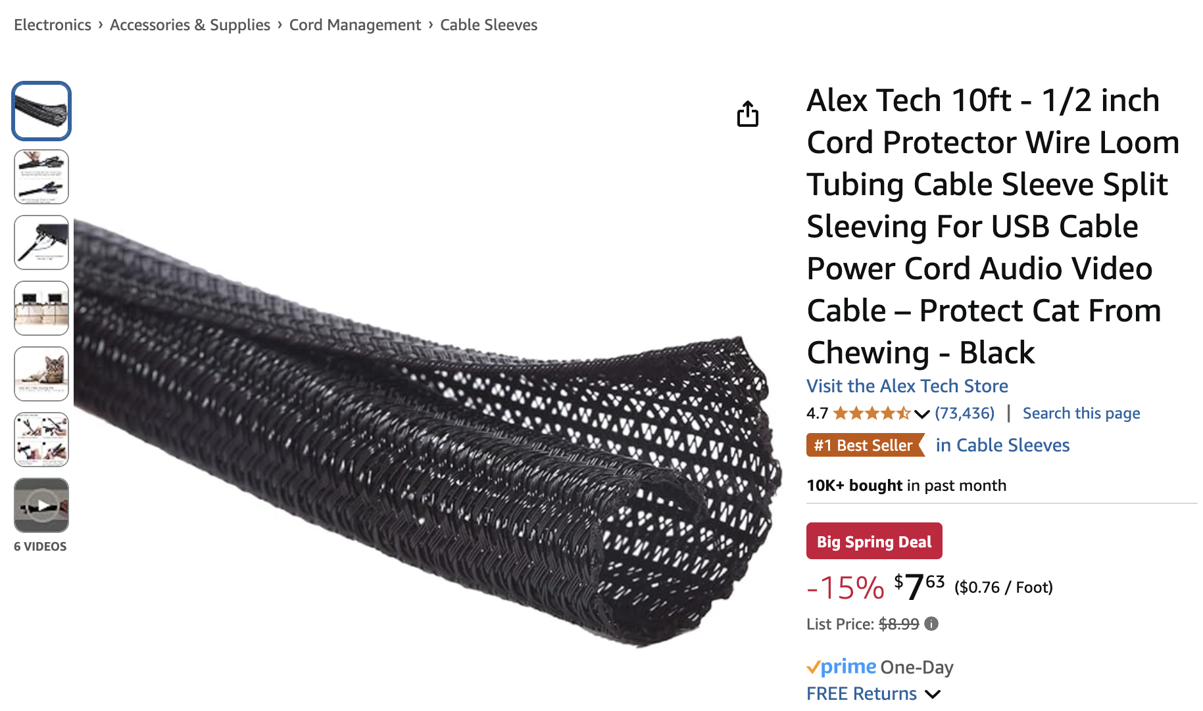
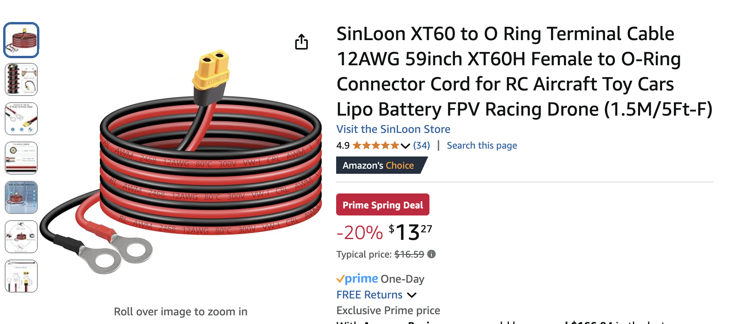
Orders Update

Slide 6
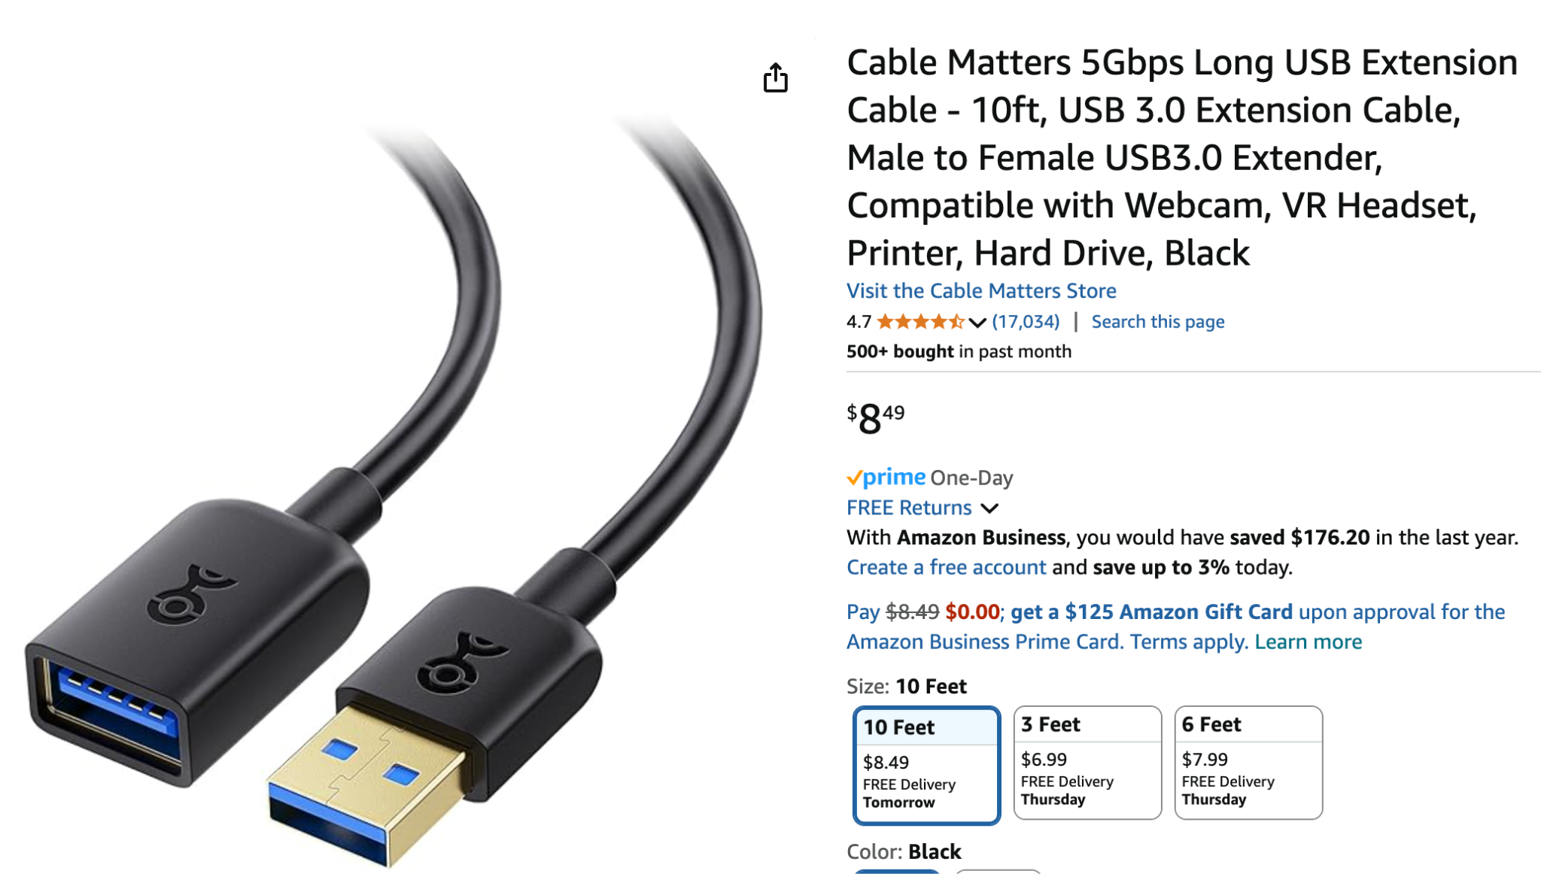
Orders Update
USB Extension Cable for R-link connection

Slide 7
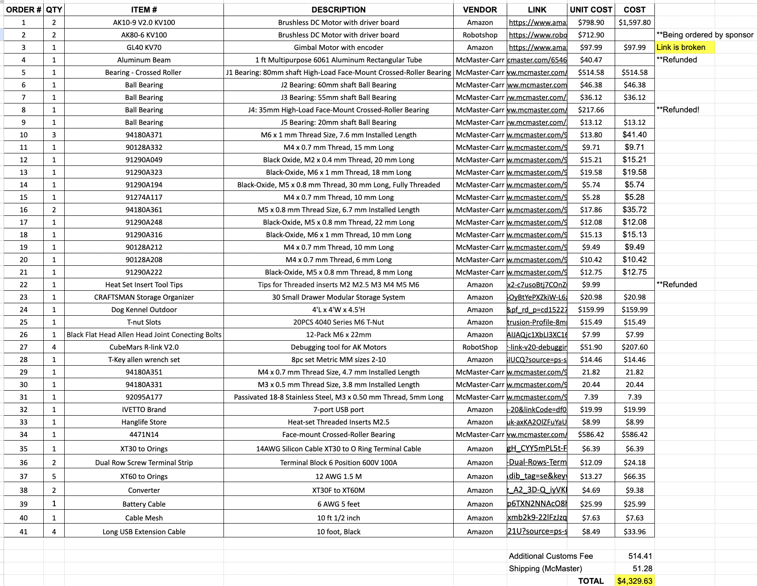
Budget Update
https://tamucs-my.sharepoint.com/:x:/r/personal/gullo_morgan_tamu_edu/_layouts/15/doc2.aspx?sourcedoc=%7B8F7B49D6-BC0F-41D8-A176-45EECC1D1487%7D&file=Final%20Organized%20BOM.xlsx&action=default&mobileredirect=true&DefaultItemOpen=1&wdOrigin=SEARCHENGINE.GOOGLE%2CAPPHOME-WEB.FILEBROWSER.RECENT&wdPreviousSession=2b88c048-9d8f-4999-9fb7-5b0a7b5ec120&wdPreviousSessionSrc=AppHomeWeb&ct=1743525401201

Slide 8
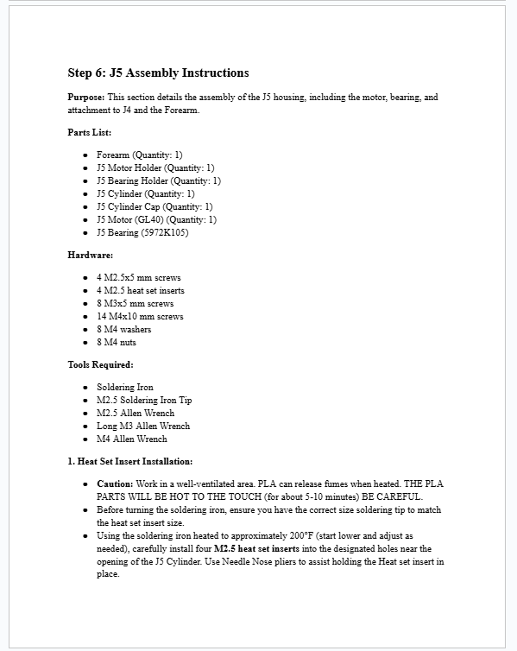
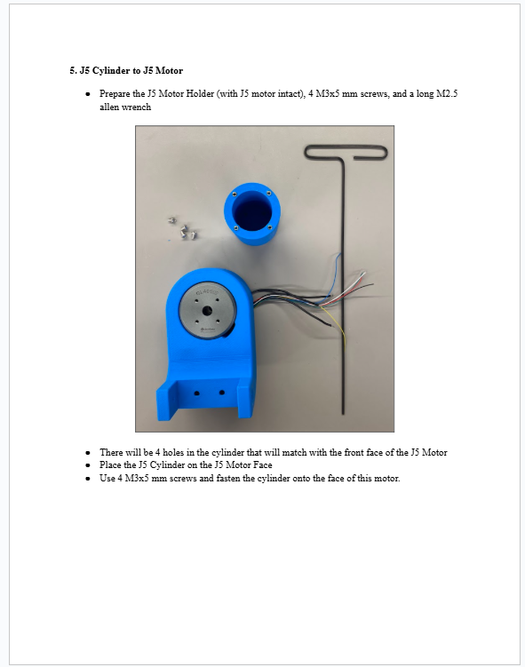
Assembly Manual
Assembly Manual 99% complete
~60 pages long (lots of figures, cover pages, etc…)

Slide 9
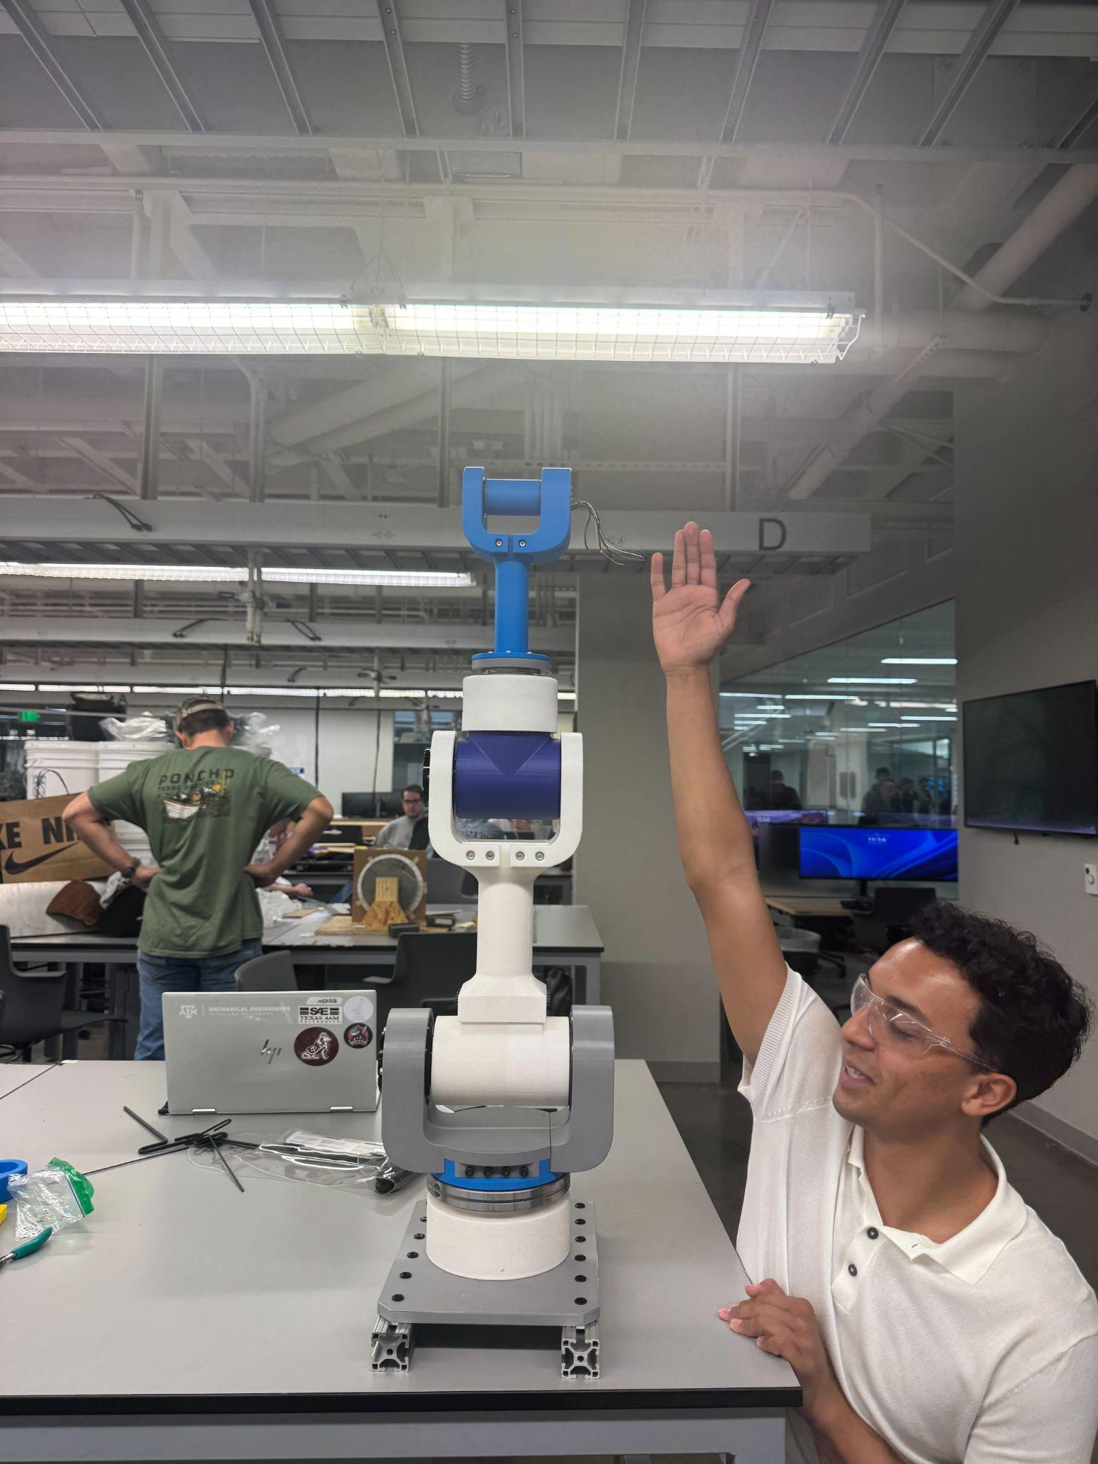
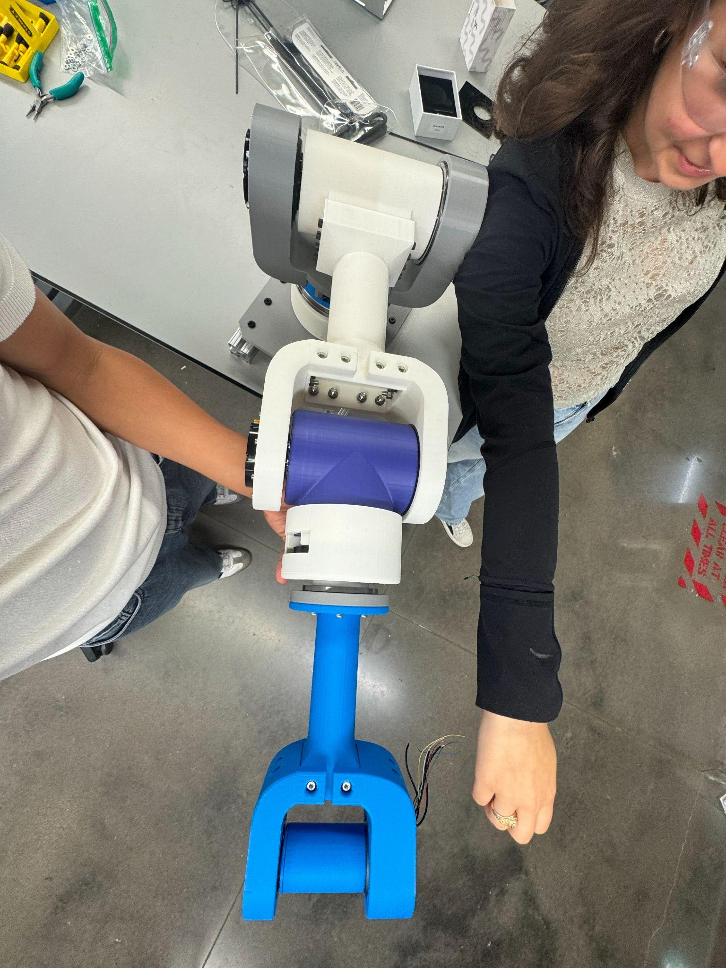
Prototype Assembly
Prototyped Assembly meets our length, and weight requirements outlined in the beginning of our project
Length is .9 m, satisfying the length requirement

Slide 10
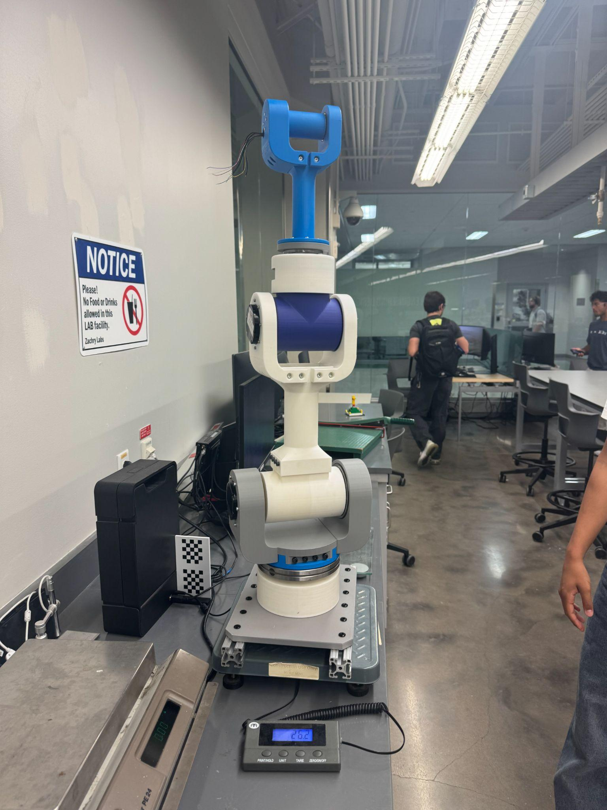
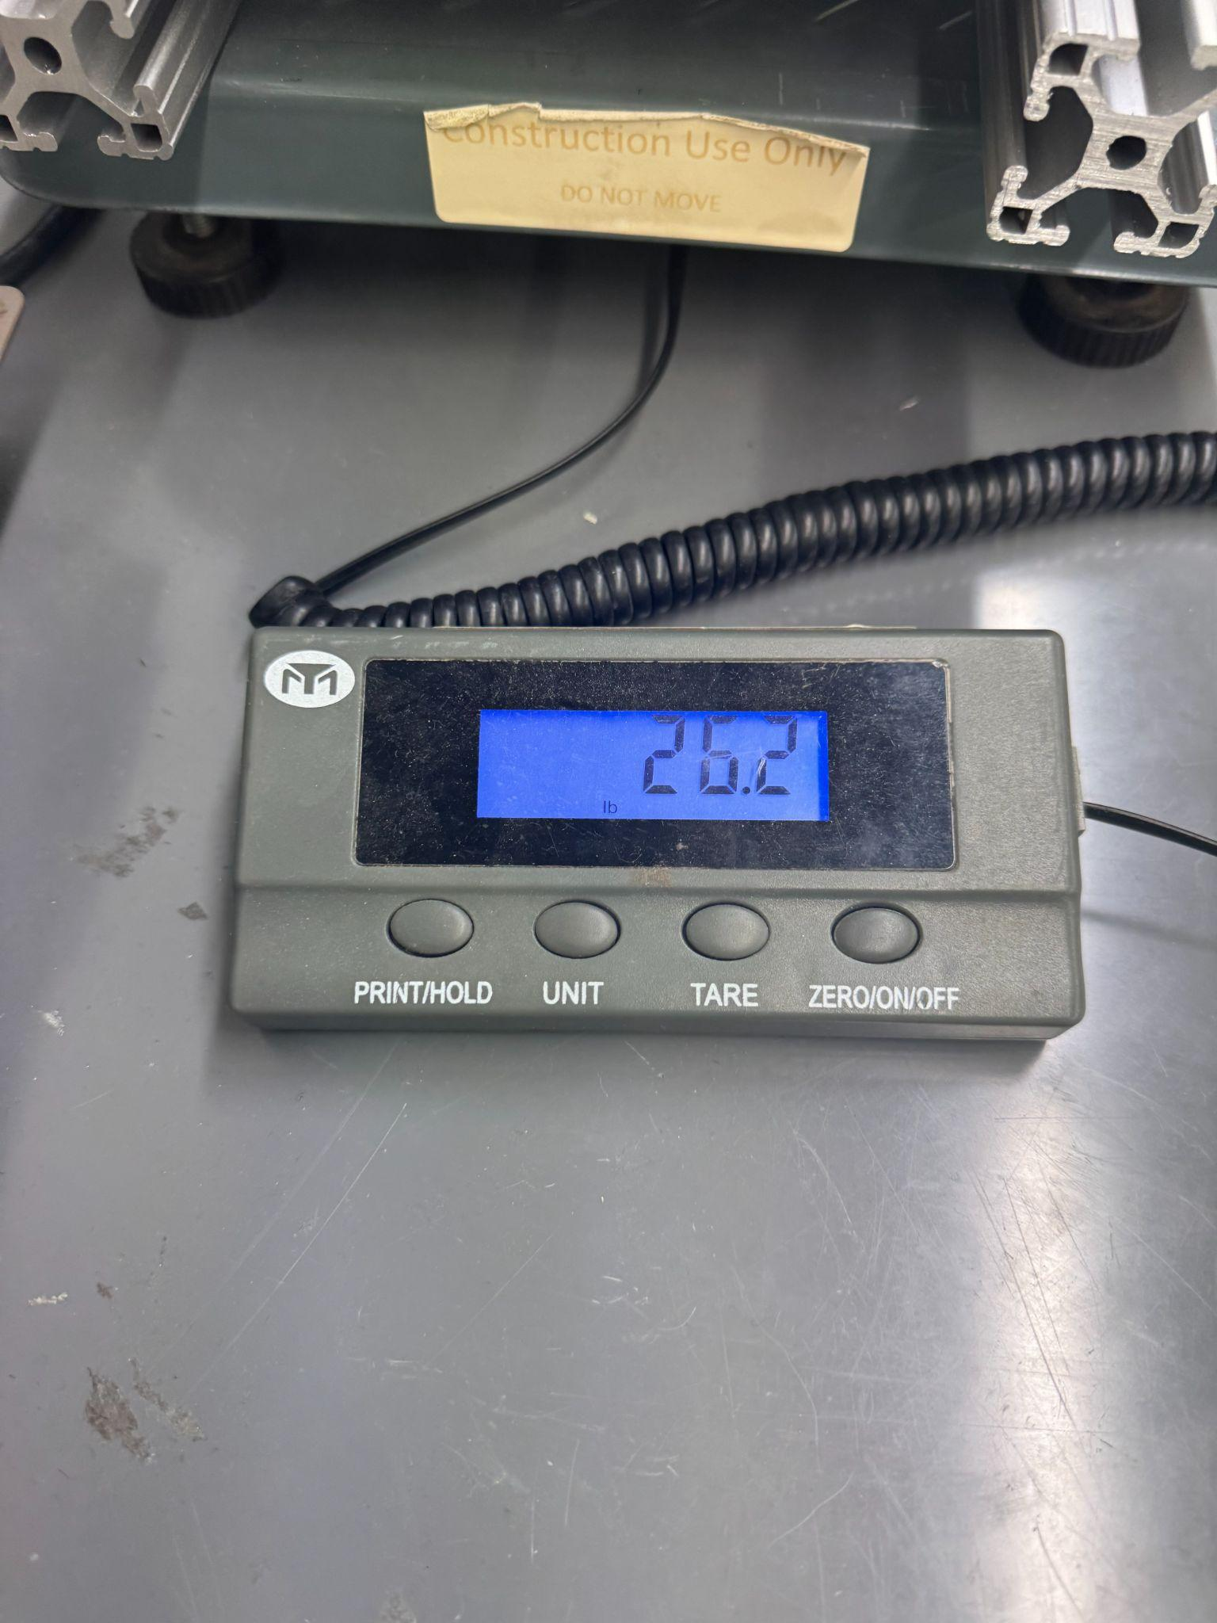
Prototyping/Assembly
Weight Update for assembly
Measured = 26.2 lb
Below our goal of 31 lbs

Slide 11
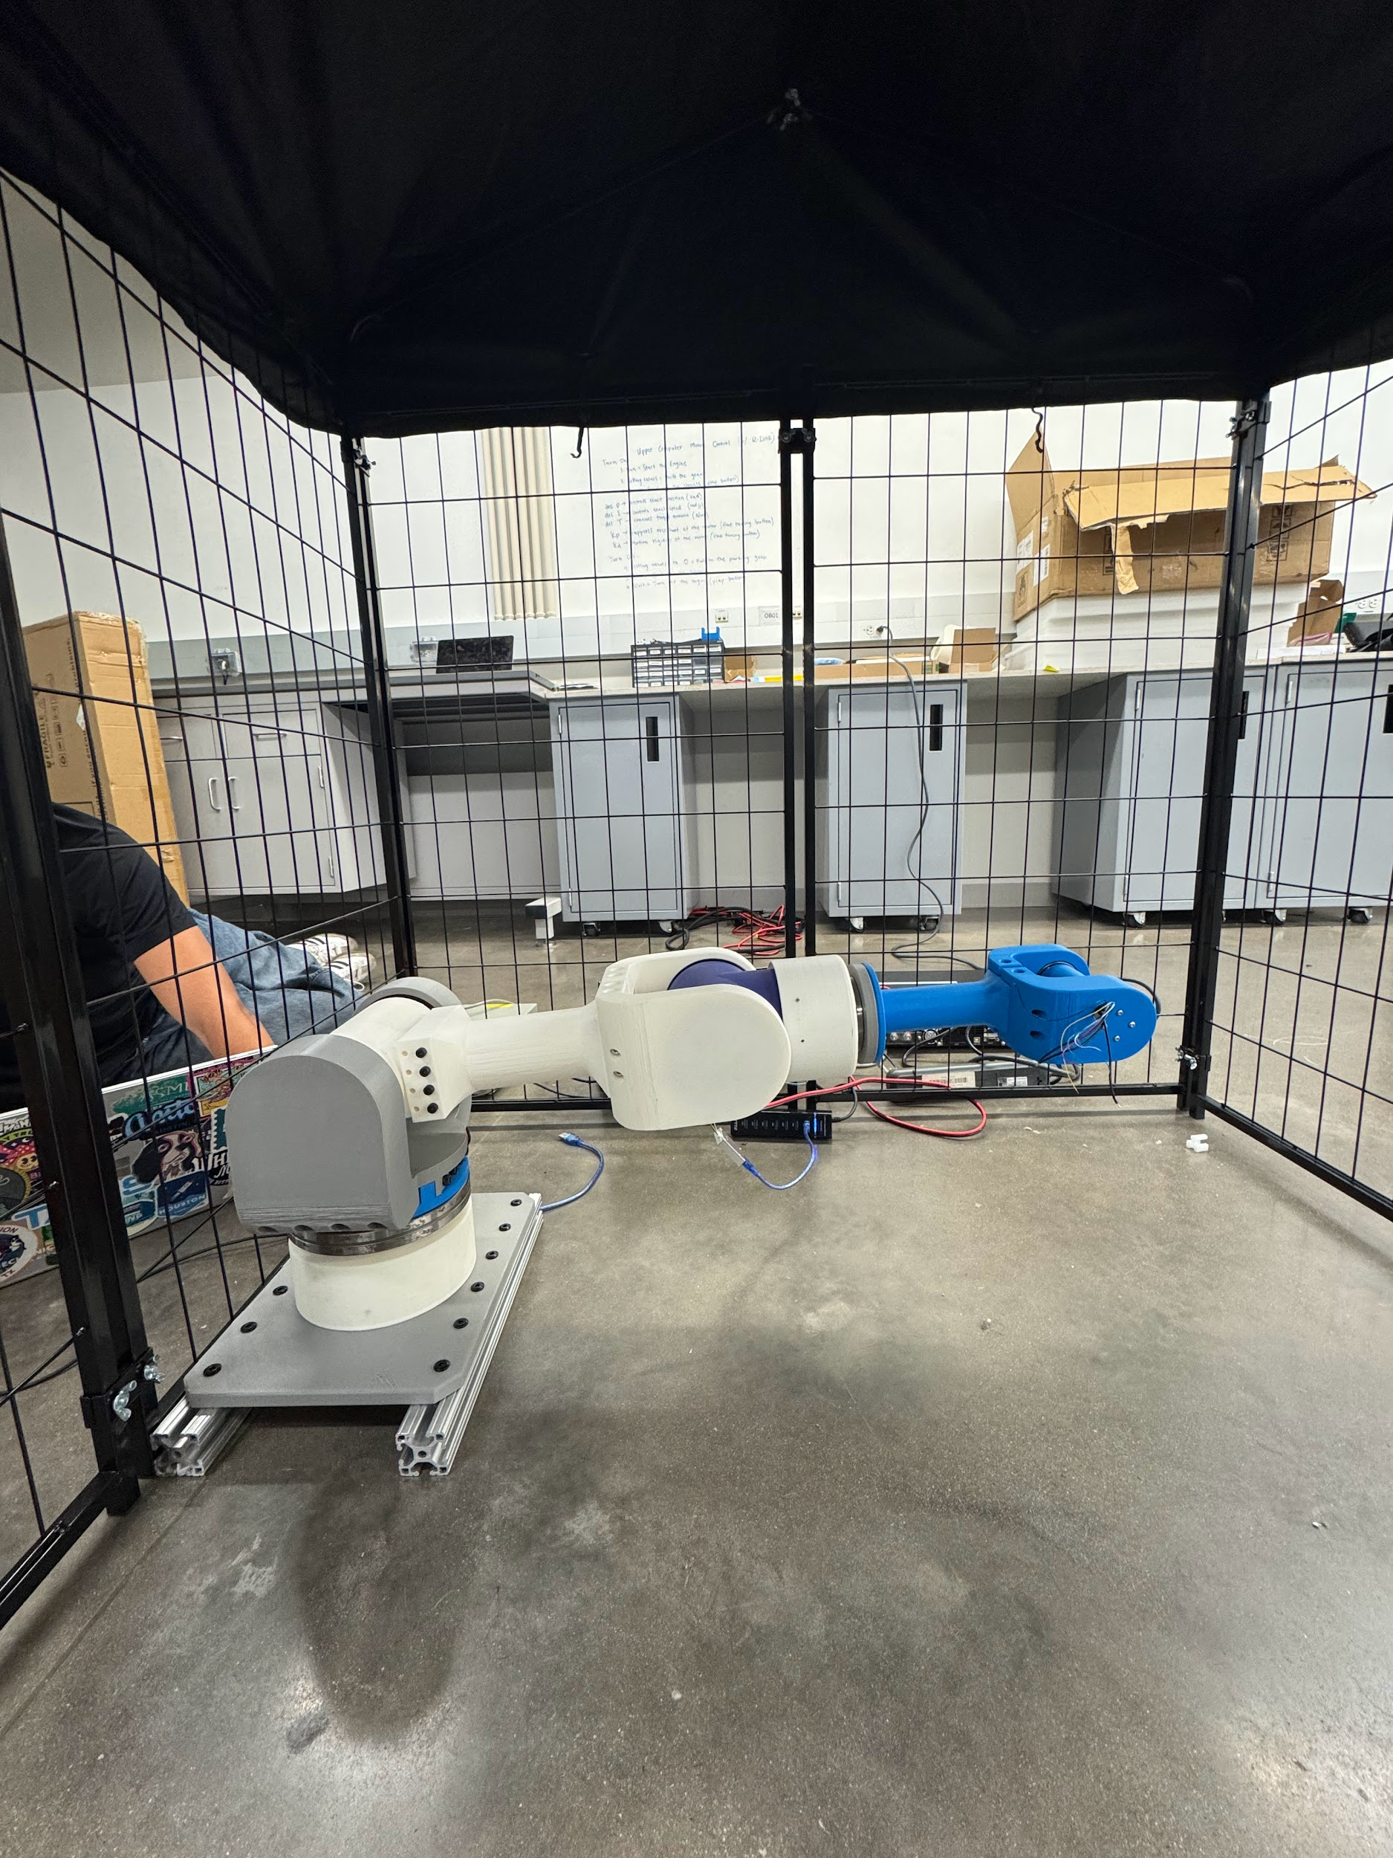
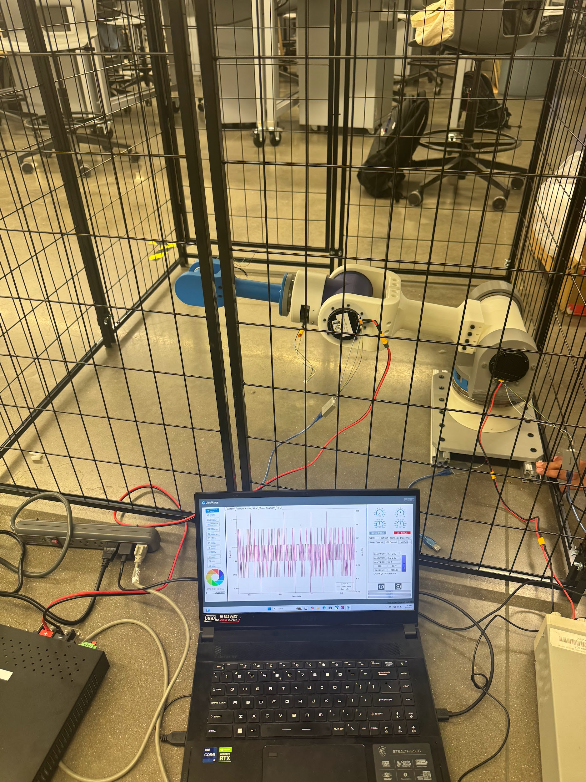
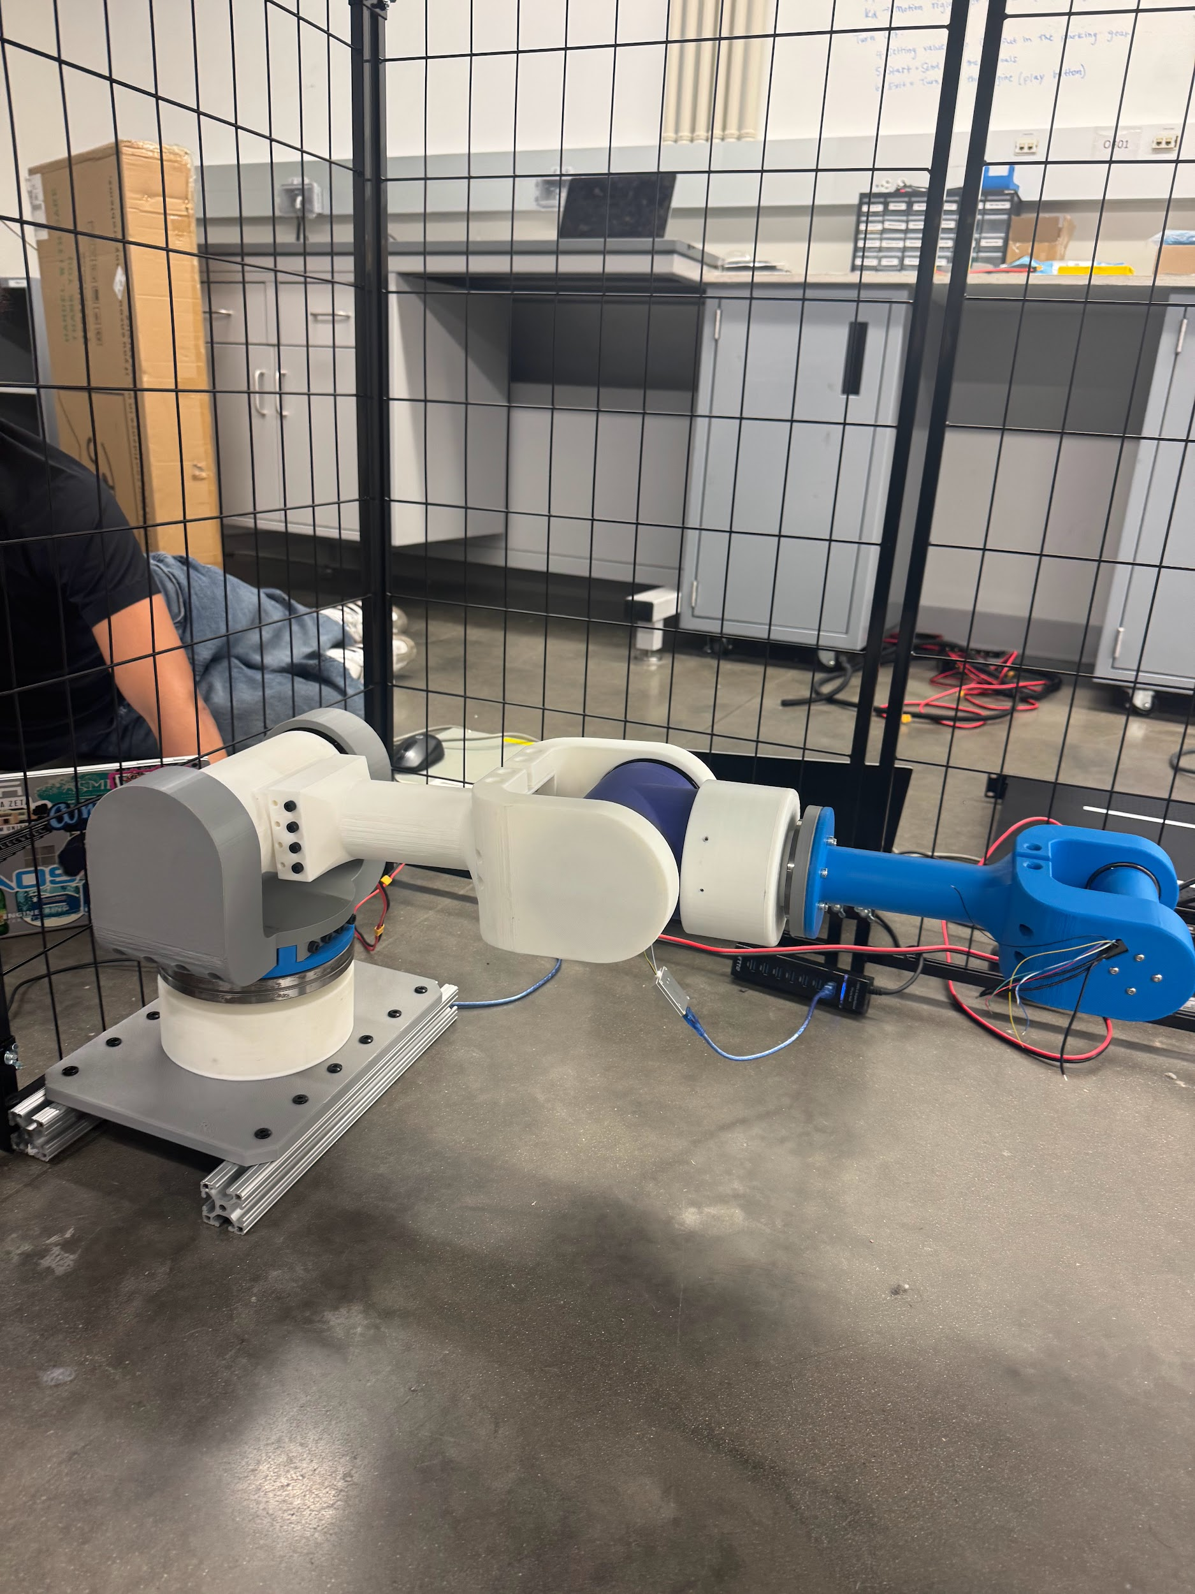
Testing
J2 Motor (with J3 off)
Torque = 12 Nm
J2 Motor (with J3 on)
Torque = 20 Nm
Amps = 0.7 A
J3 Motor
Torque = 2 Nm
Watts = 5.2 W

Slide 12
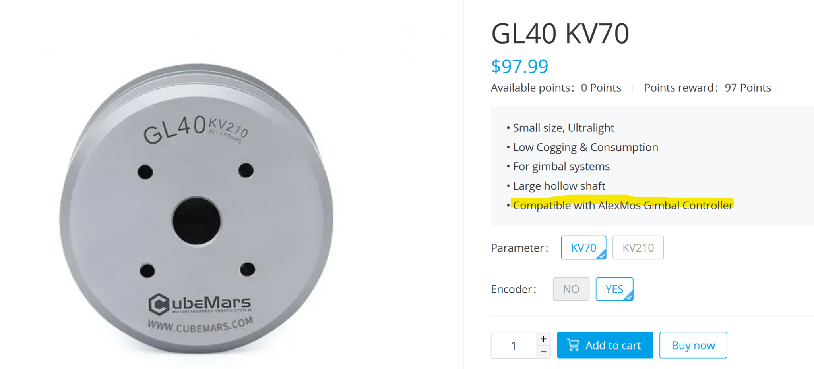
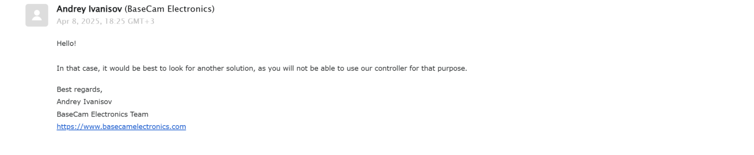
J5 Motor Testing
Investigating unexpected issues with the J5 motor
Engaging with recommended vendors to identify the appropriate motor driver
Actively exploring integration with Elmo Motion Control software

Slide 13
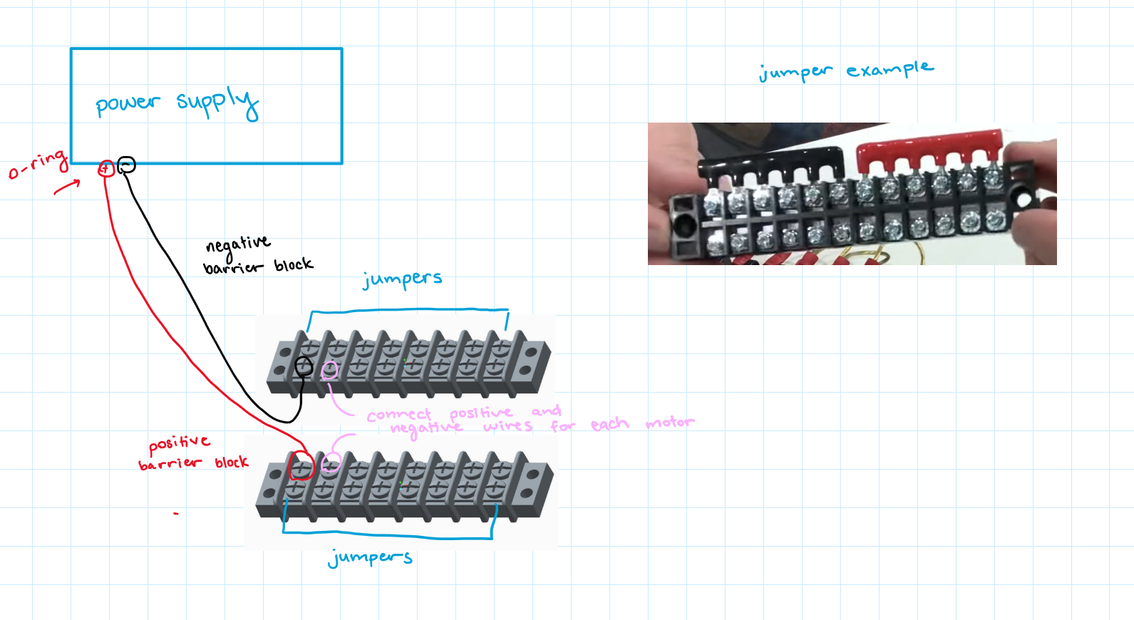
Power Supply Research
Barrier terminal blocks and jumpers will be used to distribute power to each motor.
One terminal block will serve as the negative connection, while the other will be positive.
The components must be rated for 75A and 24V to ensure safe and reliable operation.
The terminal blocks will be securely mounted to the base of our design for stability.

Slide 14
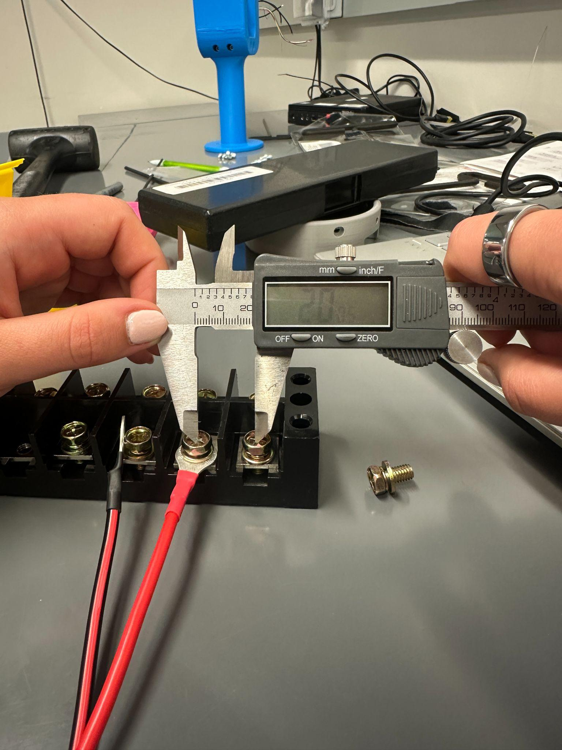
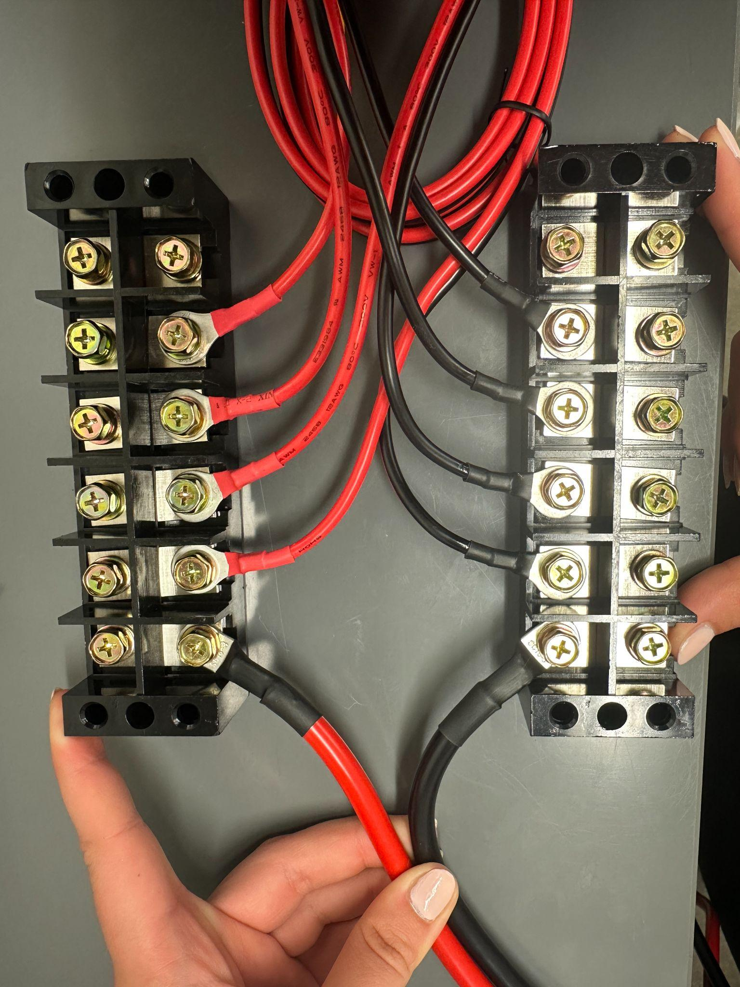
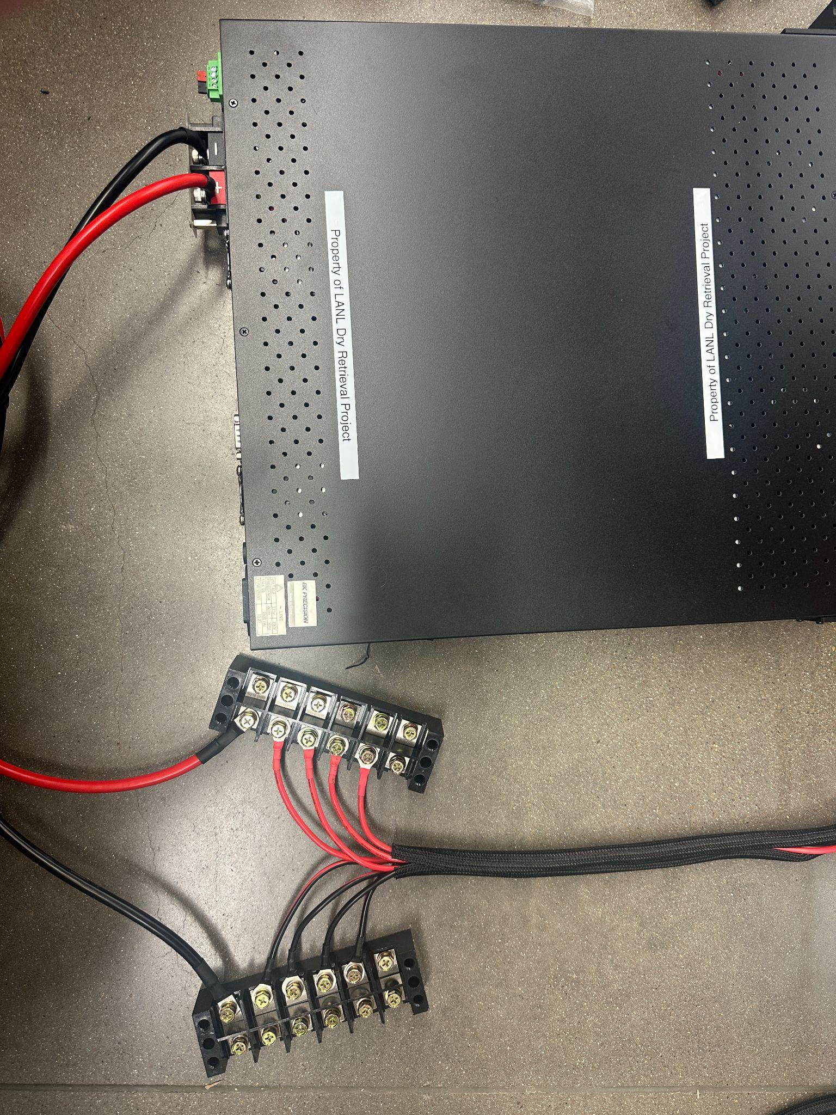
Electrical Setup

Slide 15
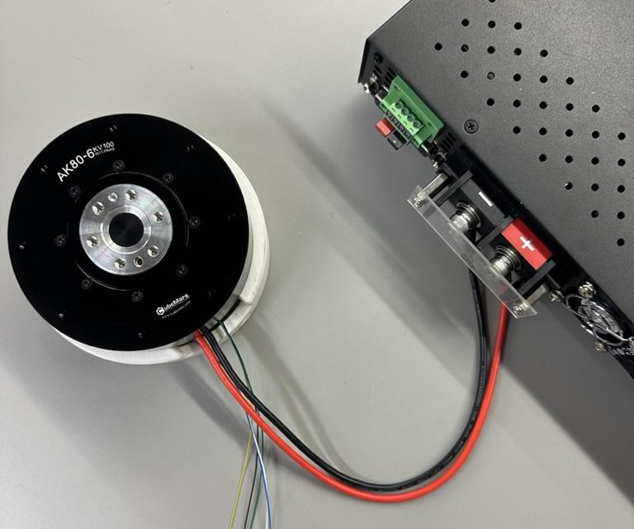
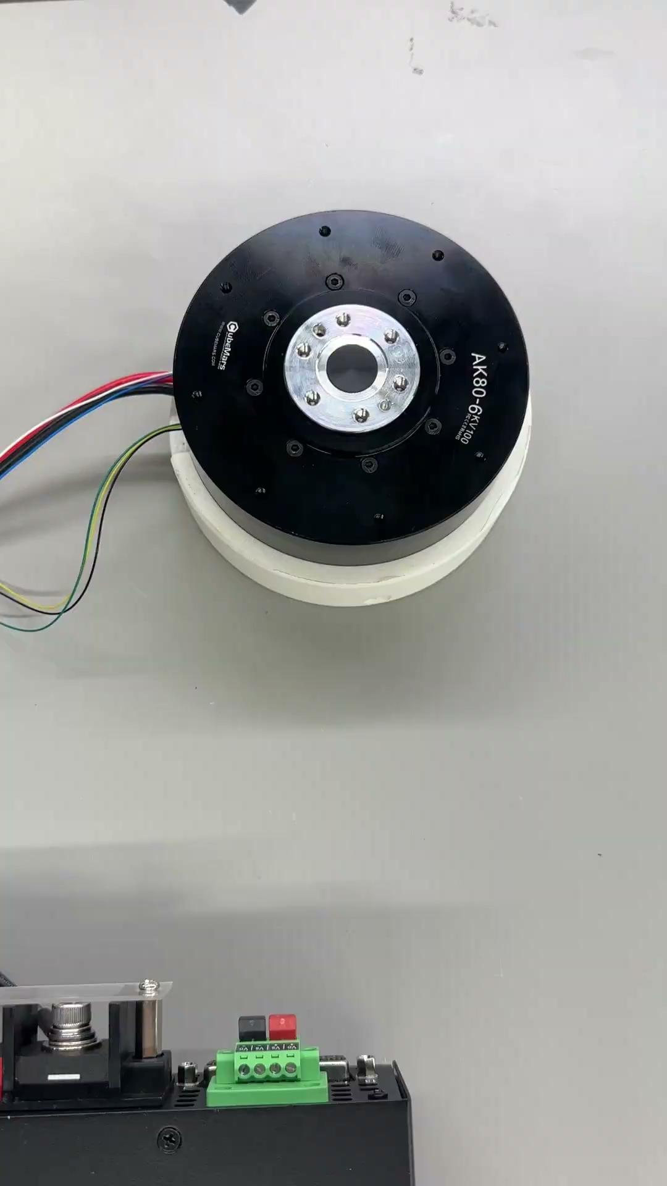
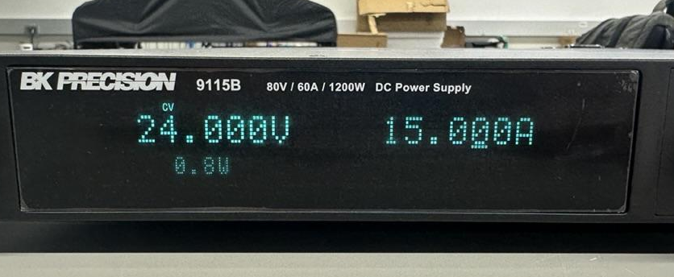
Power Supply Validation

Slide 16
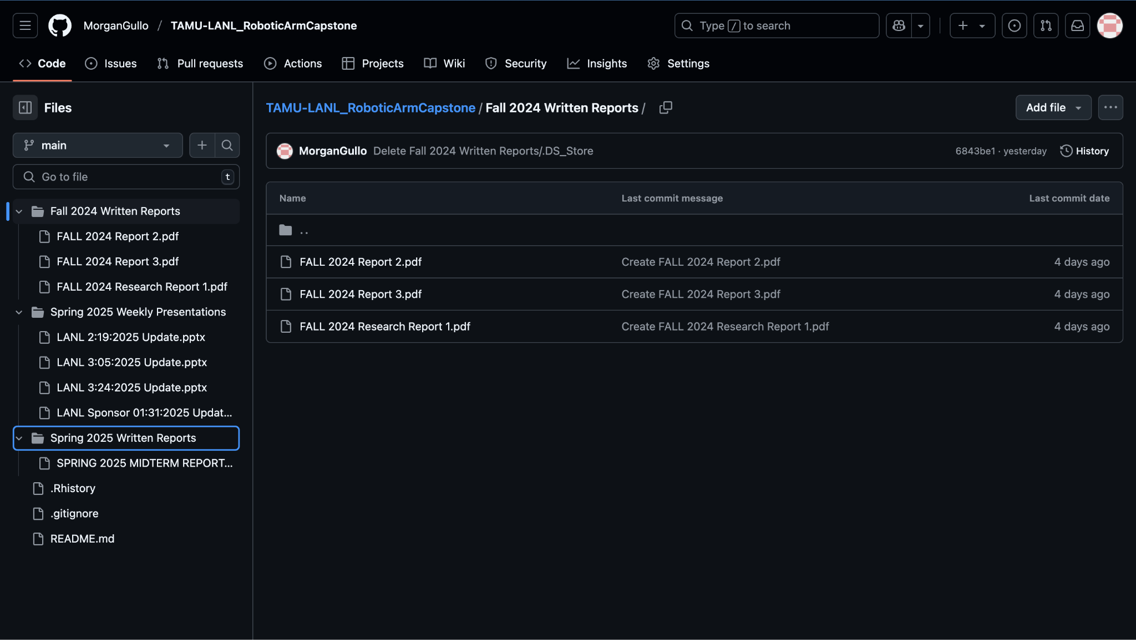
Github
https://github.com/MorganGullo/TAMU-LANL_RoboticArmCapstone/blob/main/README.md

Slide 17
Future Work
Verify electrical components
Test motors from common hub
Film milestone video
Continue GitHub repository to streamline and document the assembly process
Work on Final Report, Final Presentation, and poster
Final Presentation April 24th 5:00 - 6:00 PM in Zachry Room 256

